Slide 1
Working with the SharePoint Framework
March 15th, 2017

Slide 2
Intro
SharePoint Framework Overview
Requirements and Considerations
Demo

Slide 3

Eric Skaggs
eskaggs@outlook.com
@skaggej
http://www.ericskaggs.net
Catapult Systems
Pluralsight Author
https://github.com/skaggej/spfx

Slide 4
SharePoint Framework Overview
Why and What? #SPFx

Slide 5

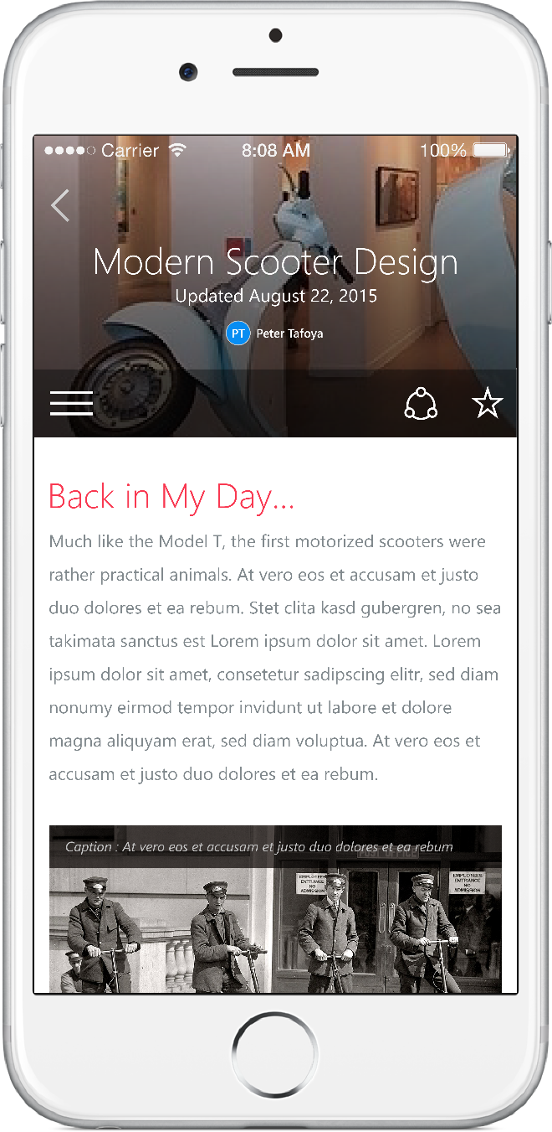
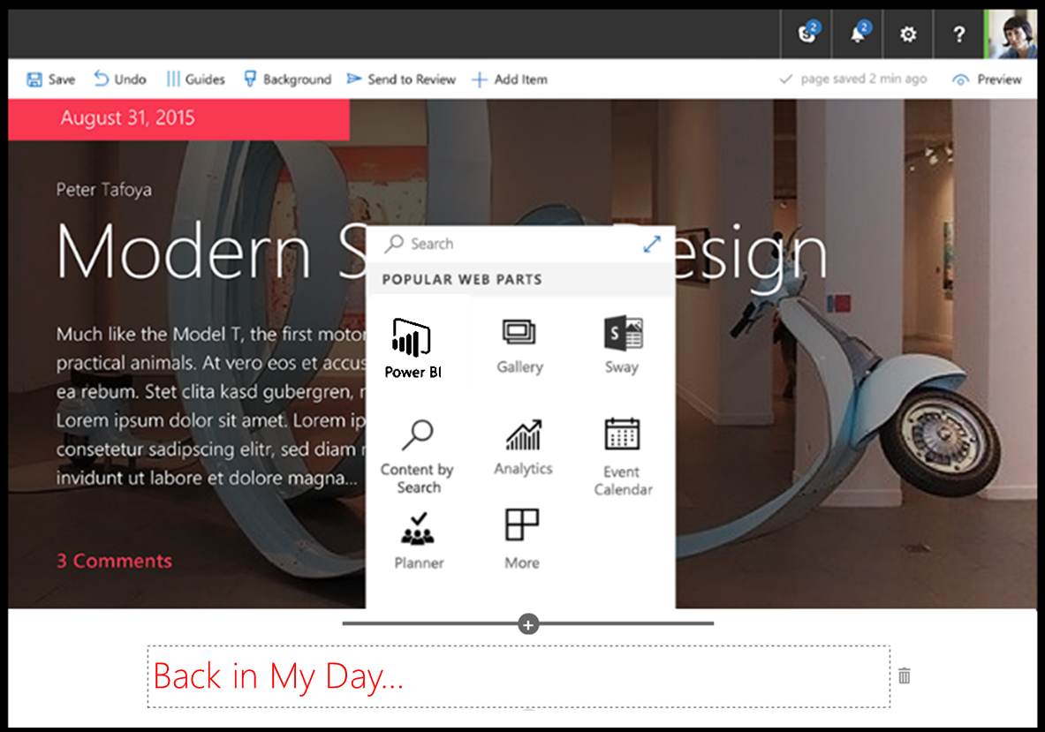
SharePoint Framework (Ignite BRK3026)
Modern client-side development
Lightweight web and mobile
Powers our own experiences
Backward compatible
Supports open source tools and JavaScript web frameworks
SharePoint framework
Microsoft Graph
LOB Systems and Cloud Services

Slide 6
#SPFx Overview – Why?
Need for cloud-capable, client-side solutions
Need for configuration options in web parts
Content Editor and Script Editor web parts, for example
iFrames are slow and interfere with responsive design

Slide 7
#SPFx Overview – What?
Page and web part model supporting client-side dev
Easy integration with SharePoint data
Support for open source tooling
Modern web technologies
Works for SharePoint Online and on-premises
No iFrames, natively responsive, lifecycle access, framework-agnostic, support for both classic and modern experiences

Slide 8
Requirements and Considerations
How? #SPFx

Slide 9
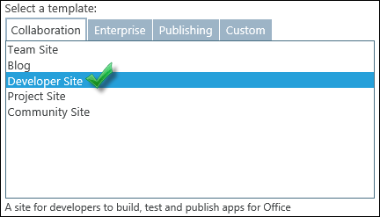
#SPFx – How?
Use SharePoint Online to test what you build…
Create an app catalog site collection
Create a development site collection

Slide 10
Option #1 – Configure Your PC
Install Node.js
Install a code editor
Install TypeScript
Included with Visual Studio Code
Install Yeoman and gulp
Install Yeoman SharePoint generator
Install other tools you might need or want
Ready to go!

Slide 11
Option #2 – Docker
Install Docker
Open the command line
mkdir spfx-first-project
docker run -h spfx -it --rm --name spfx-first-project -v /D/docker/spfx-first-project:/usr/app/spfx -p 5432:5432 -p 4321:4321 -p 35729:35729 waldekm/spfx
Ready to go!

Slide 12
SharePoint Framework Demo
Awesome! #SPFx

Slide 13
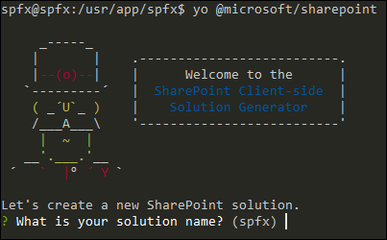
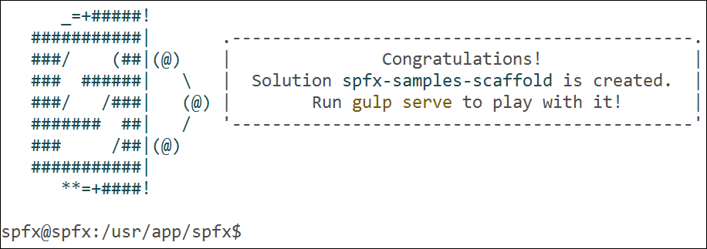
Scaffolding a New Project
“yo @microsoft/sharepoint”
A few to several minutes later…

Slide 14
Project Structure
Project
Web Part 01
Web Part 02
Web Part 03
sample01
src
webparts
helloWorld
test123

Slide 15
The SPFx Lifecycle
Dev, Test
gulp serve
Local workbench
gulp package-solution
Upload to app catalog
Add app to site
gulp serve
Add web part to page
QA, Publish
gulp package-solution –ship
Assets to CDN
{ProjectDir}/sharepoint
Upload to app catalog
Add app to site
Add web part to page

Slide 16
SPFx Fantastic 40
Not your parents’ Fabulous 40. #SPFx

Slide 17


SPFx Fantastic 40
Tiles Gallery
Photopile

Slide 18
Resources
Set up your Office 365 tenant: http://bit.ly/2c8L50Z
Set up your dev environment: http://bit.ly/2mNRyH4
#SPFx Overview: http://bit.ly/2bWijSN
#SPFx on Docker: http://bit.ly/2mysqnj (by @waldekm)
Docker: https://www.docker.com
SPFx Fantastic 40: http://bit.ly/2mptPJH (by @olivierc)

Slide 19
Eric Skaggs
eskaggs@outlook.com
@skaggej
http://www.ericskaggs.net
Catapult Systems
Pluralsight Author
https://github.com/skaggej/spfx

